Slide 1
IMAGE DENOISER
USING INTEL’S oneDNN

Slide 2
What is the work of image denoiser?
The work of an image denoiser is to remove noise or unwanted artifacts from an image while preserving the important features of the image.

Slide 3
CODE

Slide 4
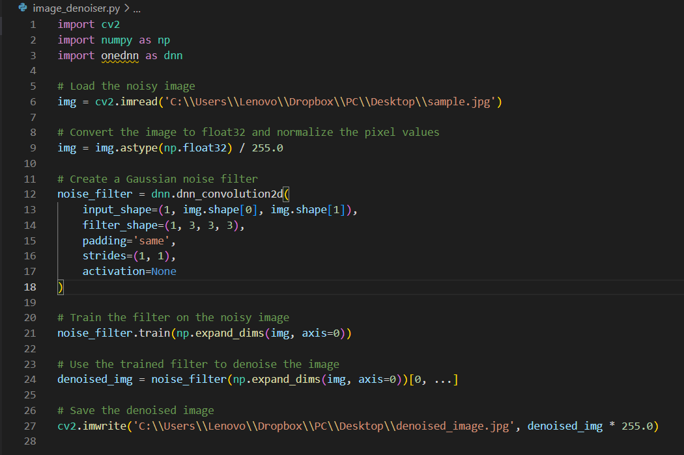

Slide 5
Thankyou

